Slide 1
Fraudulent Claim Detection Summary & Recommendations Submitted by: Ketan Chincholikar, Milan Banura, Lakhan Varshney

Slide 2
Problem Statement
Global Insure faces considerable financial losses dues to fraudulent claims
Current process is time-consuming and inefficient
Fraudulent claims are detected after the claim payment
Global Insure wants to improve the fraud detection process using data-driven insights to classify claims as fraudulent or legitimate and minimize financial losses and optimize the overall claims handling process

Slide 3
Business Objective
Build a predictive model to classify insurance claims as either fraudulent or legitimate based on historical claim details and customer profiles
Use Logistic Regression and Random Forest models to identify the key features associated with fraudulent claims

Slide 4
Data Handling
Loaded and inspected data
Handled null values
Removed missing and illogical values (e.g., negative losses)
Dropped high-cardinality identifiers
Categorical encoding and feature scaling applied using StandardScaler()
Class imbalance resolved using RandomOverSampler

Slide 5
Exploratory Data Analysis – Key Insights
Performed univariate and bivariate analysis
People with hobbies like chess and cross-fit show high fraud risk
Insured occupation like transport-moving and exec-managerial have more fraud percentage
Single Vehicle Collision and Multi-vehicle Collision have more chance of fraud
MD, PhD , JD (people with very high education level) are likely to fraud
Incidents occurring in Ohio has highest fraud likelihood
Auto make – Audi, Mercedes, Ford lead in fraud
Correlation analysis
Total claim amount and vehicle claim, property claim, injury claim
Age and month as customer
Class Imbalance
Fraud reported in ~25% of cases

Slide 6
Feature Engineering
Created binary indicators for risky segments
Combined rare categories to reduce sparsity
Applied one-hot encoding for categorical features
Used RandomOverSampler to balance classes

Slide 7
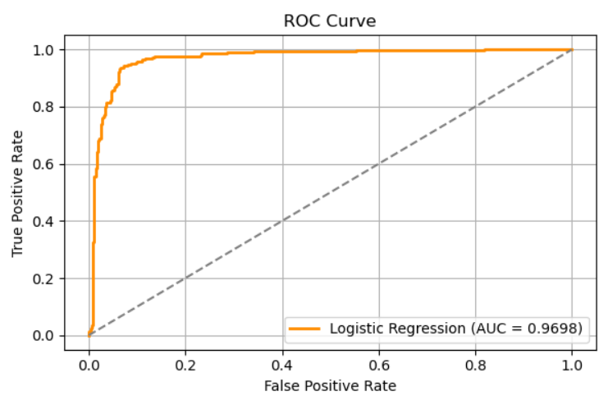
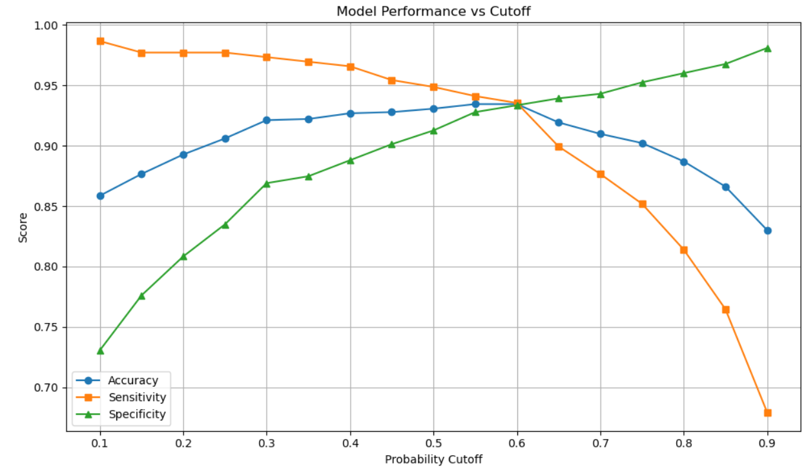
Model Building
Logistic Regression
Cutoff | Accuracy | Sensitivity | Specificity | Precision | Recall | F1 Score
0.6 | 93.5% | 0.94 | 0.93 | 0.93 | 0.94 | 0.93
Random Forest
Hyperparameter Tuning | Accuracy | Sensitivity | Specificity | Precision | Recall | F1 Score
Yes | 94.87% | 0.99 | 0.90 | 0.91 | 0.99 | 0.95

Slide 8
Model Evaluation
Logistic Regression Model
Cutoff | Accuracy | Sensitivity | Specificity | Precision | Recall | F1 Score
0.6 | 79% | 0.54 | 0.87 | 0.58 | 0.54 | 0.56
Random Forest Model
Hyperparameter Tuning | Accuracy | Sensitivity | Specificity | Precision | Recall | F1 Score
Yes | 83.67% | 0.77 | 0.86 | 0.64 | 0.77 | 0.70

Slide 9
Recommendations & Business Implications
Fraudulent claims exhibit identifiable patterns linked to incident severity, customer hobbies, customer occupation types, and education making predictive modelling highly viable
Random Forest model is recommended for operational deployment due to its superior accuracy, balanced precision and recall, and robustness after hyperparameter tuning
Logistic Regression model showed slightly lower performance; it remains valuable for its interpretability
Prioritize investigation for high-risk segments (e.g., major damage, unusual hobbies)
Enhance claims triage using predictive scores

Slide 10
Thank you
Ketan Chincholikar
Milan Banura
Lakhan Varshney

